Slide 1
Learning Improvement Program (LIP) -Preranamitra
Handholding of School Children by HEIs

Slide 2
Context
World Education Report, NAS, ASER reports alarmed about learning levels of school children in India.
Baseline surveys of few organizations in AP also cautioned about lack of “Age appropriate and Class appropriate skills”
APSCHE declared the year 2023-24 as “Year of Education” committed for enhancing Quality Education in Higher Education, but also to contribute in School Education also.

Slide 3
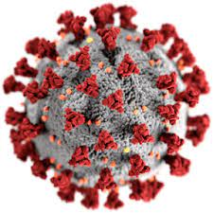
Contd..
National Achievement Survey
Annual Status of Education Report
World Education Report 2018
Adverse Impact
COVID
NAS
ASER
WorldBank
On regular participation of children in school, resulting in school closures and further learning gaps/deficits
Poor Learning outcomes
Decreasing trend in learning levels over the years
Huge learning crisis in all the developing countries including India

Slide 4
Partners
APSCHE
BCDE
AP State Council for Higher Education
Board for Community Development through Education
UNICEF
United Nations Childrens Fund
Samagra Shiksha (SS) Dept. of School Education
Sikshana Foundation
CIPS
Bal Raksha Bharat
Village and Ward Secretariat
Centre for Innovations in Public Systems

Slide 5
Collaboration...
Samagra Shiksha (SS)
Sikshana Foundation
APSCHE
BCDE
UNICEF
Handholding the convergence
Awareness campagin and monitoring
Building the capacities of BCDE coordinators and mentoring
Extending technical assistance - Preranamitra app
Bridging the gap between HEI and Dept. of School Education

Slide 6
Achieving grade/age specific learning outcomes
Implementation
LIP
Prerana Mitra
Govt. of AP
FLN Skills
Classes 1 - 5 i.e. after school hours or on saturdays
Aspiring for overcoming these challenges and to make AP as top performer in Education.
Stregnthening Foundational Literacy and Numeracy skills

Slide 7
Key elements
Community Service Project (CSP) | May-June (or) every saturday | (i) All College Principals and BCDE coordinators shall encourage students to register in Prerana Mitra App (ii) UNICEF and Sikshana Foudation shall jointly organize the online/offline training program (iii) 20 modules of e -content (activity based) uploaded on the Prerana Mitra app to guide the HEI students | 180 hrs
Short term internship | As per academic calendar |  | 2 month

Slide 8
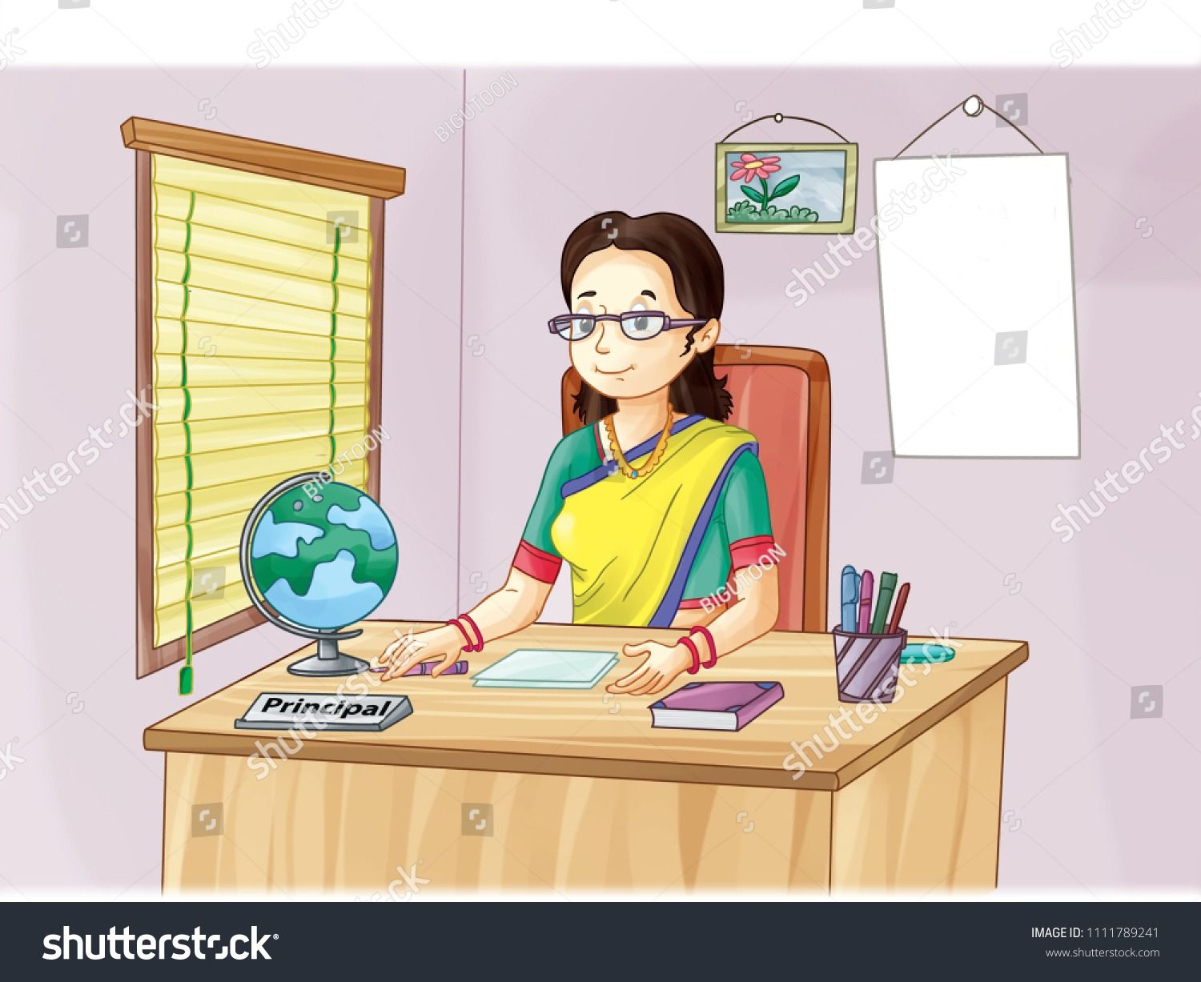
Role of Universities
University
Principal
Submission
Authorities and CDCs to develop clear guidelines for considering LIP as CSP
Encourage students to register and monitoring at frequent intervels
Submitting the list of successful students for getting certificates
Nodal Officer
Accolades
Acknowledge student efforts time to time
Designated BCDE/ CSP coordinator

Slide 9
Contd..
Task
Principals
Preranamitra App
Encouraging students for registering as Preranamitras
Demo on Preranamitra app to HEI students
BCDE coordinator
e content
Orientation for BCDE Soldiers
Join hands to build the next generation
Introducing activities for engaging primary school students

Slide 10
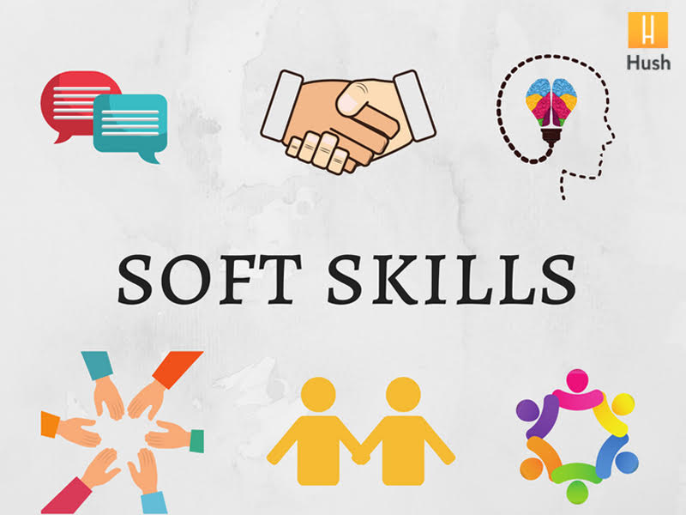
How can I benefit from CSP
Certificate I
Certificate II
Signed by the Chief, UNICEF, BCDE and Samagra Shiksha
GoI - by registering in Vidyanjali portal 2.0
Soft Skills
Study Abroad
Better communication skills and high levels of confidence
Display CSP as Service Learning Program
Placement
CV/resume
To showcase leadership qualities and team work skills
Field experience - to describe proble solving and organizational skills

